Slide 1





Predictive Analytics for Product Re-Stocking
Forecasting Feb 2019 Based on Jan 2019 Sales
By Neha S Soni
01

Slide 2

Problem Statement
Problem:
The shop owner provided January 2019 sales data but faces difficulty planning product re-stocking for February. The goal is to prioritize products for restocking based on January trends, despite having only one month's data and no seasonal patterns for reference.
Need for Solution:
A data-driven approach is crucial to optimize inventory levels, prevent stockouts, and avoid overstocking. Predictive analytics helps forecast demand, balancing inventory needs with efficient capital and storage use.
02

Slide 3
Technology used -
Microsoft Excel:
Used for data cleaning, removing duplicates, and calculating the sales price. It also helped with handling date and time formatting for accurate analysis.
MySQL:
Performed advanced analysis like calculating total sales, identifying weekly trends, and determining reorder points. SQL was essential for querying the data efficiently and gaining deeper insights.
Microsoft Power BI:
Created visualizations such as charts and graphs to highlight sales trends and product performance. It helped visualize demand forecasts clearly and concisely, making it easier for the shop owner to take action.
Microsoft PowerPoint:
Used to structure and present this analysis in a professional manner, ensuring the findings are clear and actionable.
03

Slide 4
Data Collection and Cleaning
Source of Data:
The sales data for January 2019, including information on products, quantities ordered, sales price, order dates, and customer addresses, was collected from Kaggle.
Data Cleaning Process:
Removed duplicates and blank entries.
Calculated sales price based on price per item and quantity sold.
Handled date and time formats, ensuring that sales were categorized correctly by day, which is crucial for weekly trend analysis.
04

Slide 5
Data Insights from SQL Queries
Key SQL Queries Performed:
Total Sales and Quantity Sold: Identified the total sales value and the number of units sold for each product in January. This helps in understanding the top-performing products.
Weekly Sales Trends: Calculated weekly sales for each product, identifying which products performed best during each week of January.
Forecast for February: Estimated the expected demand for February based on the weekly average sales for January, assuming that the sales trend continues similarly.
Reorder Points: Calculated reorder points for each product, factoring in the lead time for restocking, and adjusted based on each product’s contribution to total revenue.
Results:
MacBook Pro Laptops had the highest revenue contribution and sales volume in week 4.
AAA Batteries had the highest units sold but contributed the least to overall revenue, highlighting the need for strategic reordering.
05

Slide 6
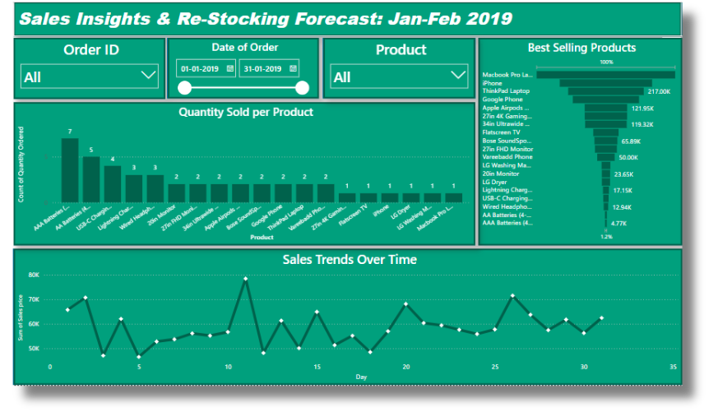
Power BI Visualizations
Key Visualizations:
Weekly Sales Trends: A line chart showing the weekly performance of top-selling products, helping identify peak sales periods.
Reorder Points: A bar chart showing reorder points for each product, ensuring stock levels are sufficient for February based on lead times.
Contribution to Revenue: A pie chart illustrating the percentage contribution of each product to the total sales revenue of January, helping prioritize which products need to be restocked first.
06

Slide 7
Conclusion
Key findings:
The MacBook Pro Laptop had the highest sales in week 4 and was responsible for over 21% of total revenue, making it a priority for restocking.
AAA Batteries, despite being sold in high quantities, contributed only a fraction of the revenue, suggesting that stock decisions should consider revenue contribution rather than just unit sales.
Significance:
The analysis provides a clear understanding of which products to prioritize for re-stocking, ensuring that high-revenue items are available for sale and preventing stockouts.
07

Slide 8
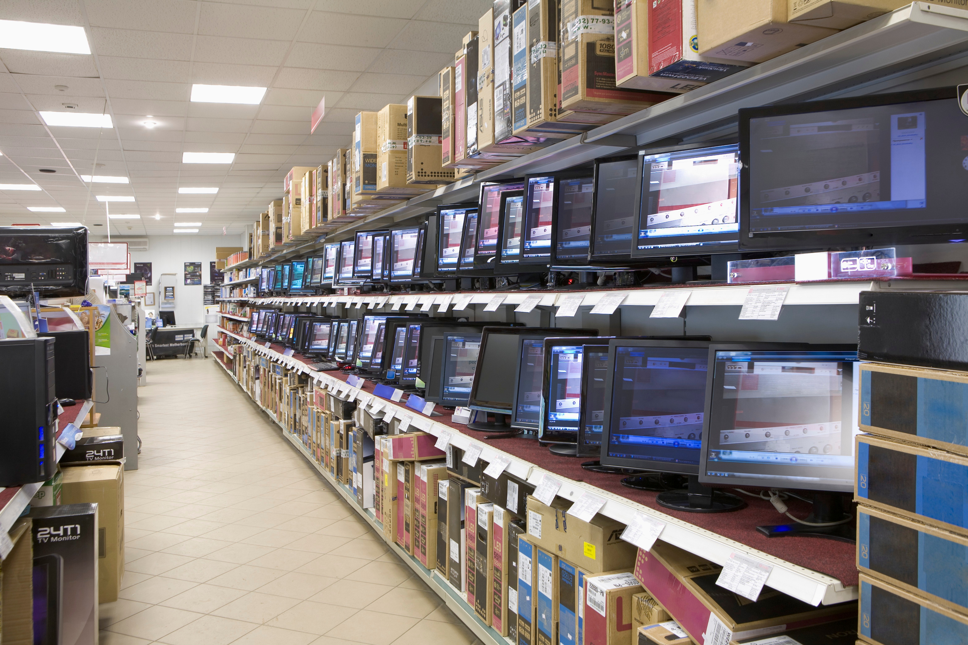
Result Analysis
Predicted Demand:
The forecast for February suggests maintaining a similar sales trend as January, with products like MacBook Pro Laptops needing priority reordering based on their high contribution to revenue.
Benefits:
Predictive analytics helps in better stock management, reduced overstocking, improved cash flow, and better customer satisfaction by ensuring popular products are readily available.
07

